Slide 1
Computational Thinking and 21st Century Skills Orientation Program Sri Lanka Institute of Information Technology
Hardware and Software

Slide 2
Delivered by
Dr. Sanvitha Kasthuriarachchi
Department of Information Technology
Faculty of Computing
SLIIT

Slide 3
Lecture content
Software
Hardware

Slide 4
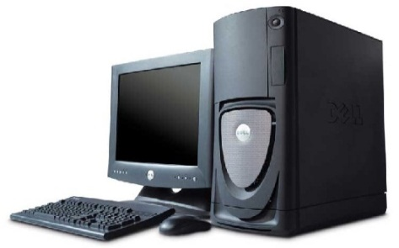
Information system
What is a System?
A set of components get together for a particular purpose / to deliver a common service
A system has inputs, which will be processed and produced as output
Information System
Process
(by software)
Data
Information

Slide 5
Components of an Information System
Components
Hardware - Equipment such as computers
Software - Instructions for the equipment
Stored Data - Facts stored in the system
Personnel - People who operate the system
Procedures - for the people to follow

Slide 6
hardware

Slide 7
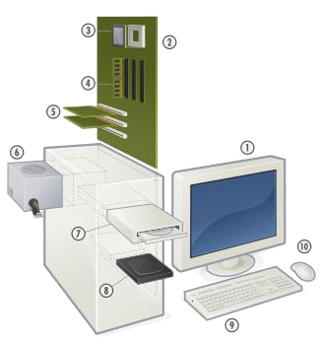
Types of Hardware
Input devices
Output devices
Processing devices
Storage devices
Other devices
– Motherboard, Expansion cards, Power supply

Slide 8
Input / Output (I/O)
Refers to the process of getting information into and out of the computer.
Input: Those parts of the computer receiving information to programs.
Output: Those parts of the computer that provide results of computation to the person using the computer.

Slide 9
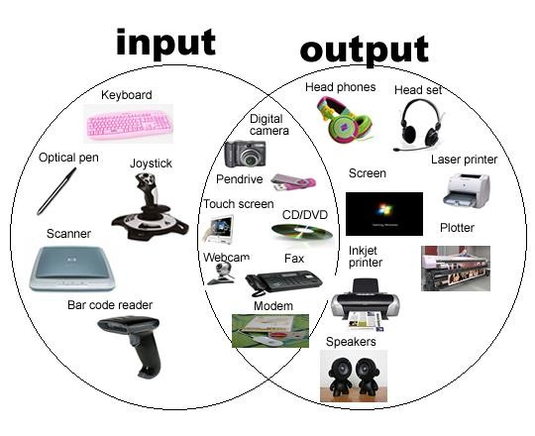
Components of the Computer - Input and output devices

Slide 10
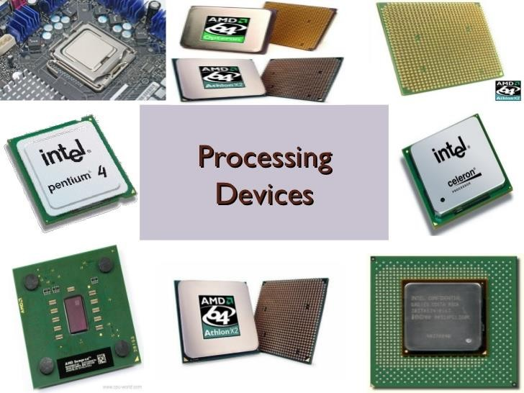
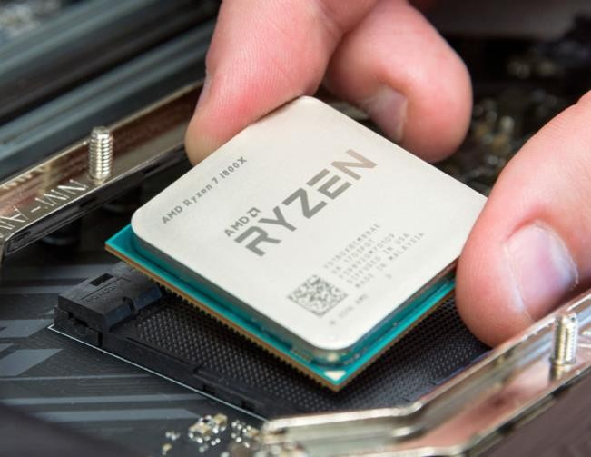
Components of the Computer -Processing devices

Slide 11
The Central Processing Unit
Responsible for controlling all activities of the computer system.
The three major components of the CPU are:
Arithmetic and Logic Unit
Control Unit
Registers

Slide 12
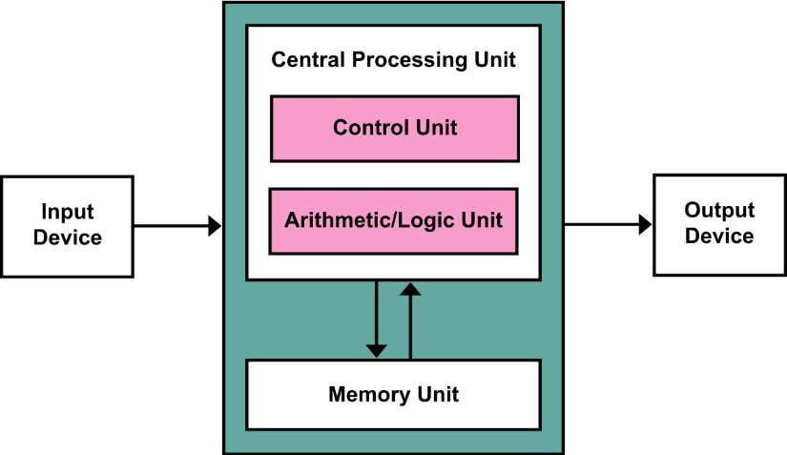
von Neumann Architecture
The basic structure of the “von Neumann machine” (or model).
a memory, containing instructions and data
a processing unit, for performing arithmetic and logical operations
a control unit, for interpreting instructions

Slide 13
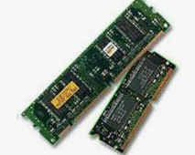
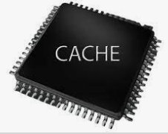
Components of the Computer Storage Devices
Primary storage
Registers
Main Memory
Cache

Slide 14
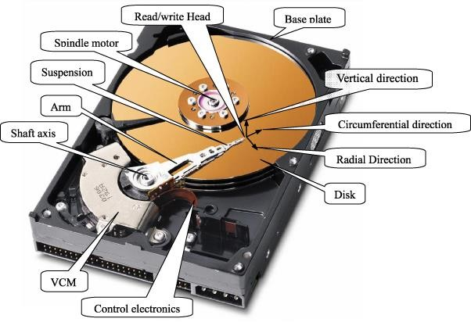
Components of the Computer Storage Devices
Secondary storage
Hard disk

Slide 15
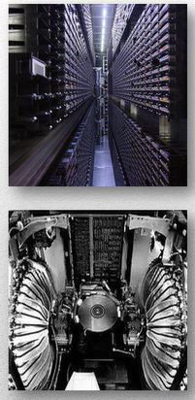
Components of the Computer Storage Devices – Tertiary Storage
This is primarily useful for extraordinarily large data stores, accessed without human operators.

Slide 16
Components of the Computer Storage Devices
Offline storages
Floppy Disk
CD/DVD/Blue-ray
USB Flash Drive
Memory Cards

Slide 17
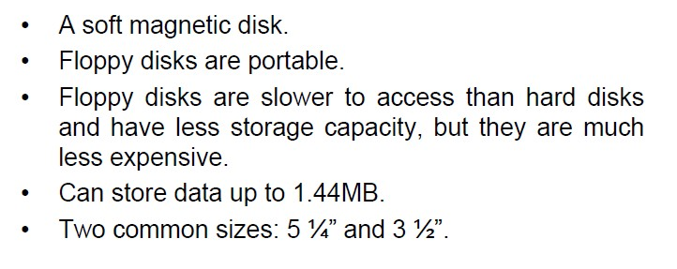
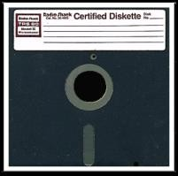
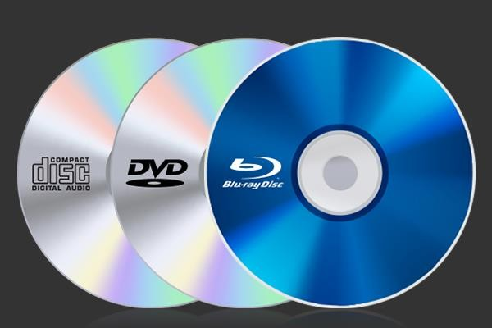
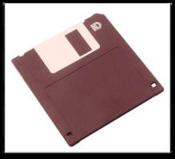
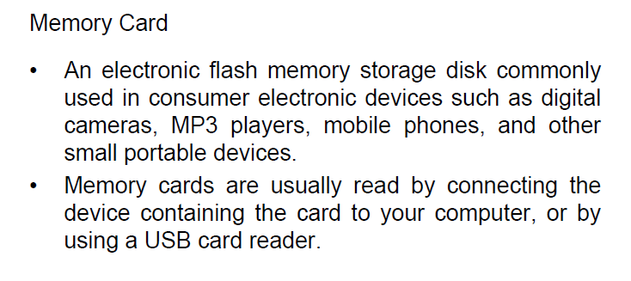
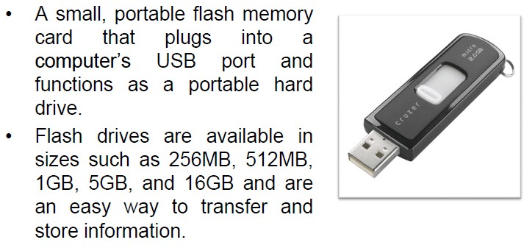
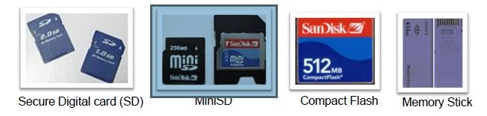
Components of the Computer Storage Devices – Offline Storage

Slide 18
The Central Processing Unit
Responsible for controlling all activities of the computer system.
The three major components of the CPU are:
Arithmetic and Logic Unit
Control Unit
Registers

Slide 19
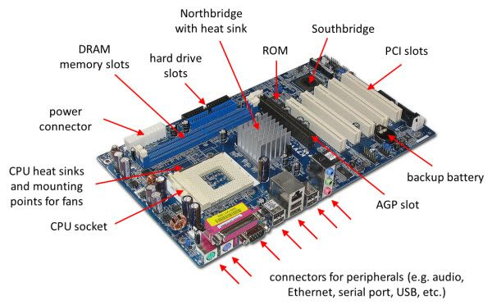
Motherboard
The place where most of the electronics including the CPU are mounted.

Slide 20
Software

Slide 21
Computer Software
The HW needs SW to be useful; the SW needs HW to be useful
When the user needs something done by the computer, he/she gives instructions in the form of SW to computer HW
These instructions need to be written in a language that is readily understood by computer

Slide 22
Hardware and Software Relationships
User Interface
Application Programs
User Interface
Operating System
User
User
Interface
Basic Input and Output Services (BIOS)
needed for a computer to boot up
Computer Hardware

Slide 23
Types of Software
System Software
Programs that generally perform the background tasks in a computer. These programs, many times, talk directly to the Hardware
Application Software
Programs that generally interact with the user to perform work that is useful to the user. These programs generally talk to the Hardware through the assistance of system software

Slide 24
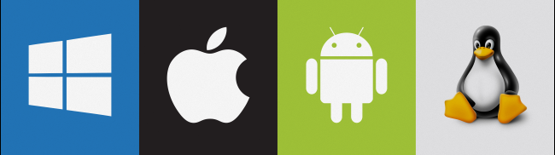
Operating System
Performs its work invisibly to control the internal functions of a computer, e.g. maintaining files on the disk drive, managing the screen, controlling which tasks to be performed and in what order
It interacts directly with the computer hardware
Other software normally does not directly interact with the hardware, but through the Operating system

Slide 25
Responsibilities of an Operating System
Communicate with user, receive and execute commands, show error messages.
Manage allocation of memory, processor time and other resources.
Collect input from keyboard, mouse, and provide data to running programs.
Convey program output to screen, printer, or other output device.
Access data from secondary storage.
Write data to secondary storage.
Maintains security (checks user-name , password, virus infection)

Slide 26
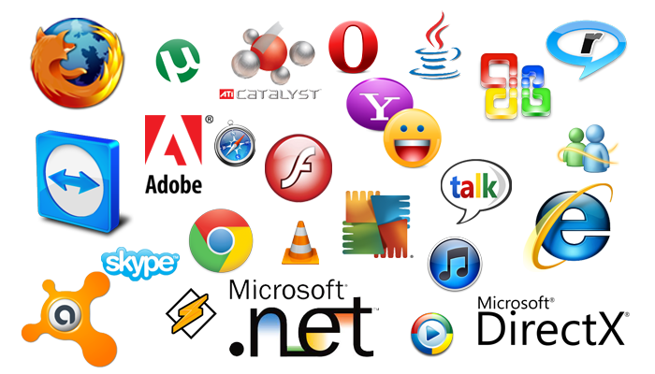
Application Software
Application software makes computer popular and easy to use

Slide 27
Types of Software Systems - Scope
Personal Information Systems
E.g. MS Office
Workgroup Information Systems
E.g. Office automation system
Organizational Information Systems
E.g. Banking solution
Inter-organizational information systems
E.g. Inter-bank systems (SLIPS, RTGS)
Global information systems
E.g. Global banking system

Slide 28
Types of Software Systems - Function
Transaction Processing Systems (TPS)
Management/Executive Information Systems (MIS/EIS)
Decision Support Systems (DSS)
Knowledge Management Systems (KMS)
Artificial Intelligent Systems (AIS)
Notes:
TSP: Transaction Processing System (TPS) is a type of information system that collects, stores, modifies and retrieves the data transactions of an enterprise. A transaction is any event that passes the ACID(Atomicity, Consistency, Isolation , Durability) test in which data is generated or modified before storage in an information system
DSS: Decision Support Systems (DSS) are a specific class of computerized information system that supports business and organizational decision-making activities. A properly designed DSS is an interactive software-based system intended to help decision makers compile useful information from raw data, documents, personal knowledge, and/or business models to identify and solve problems and make decisions.

Slide 29
The end

